Slide 1
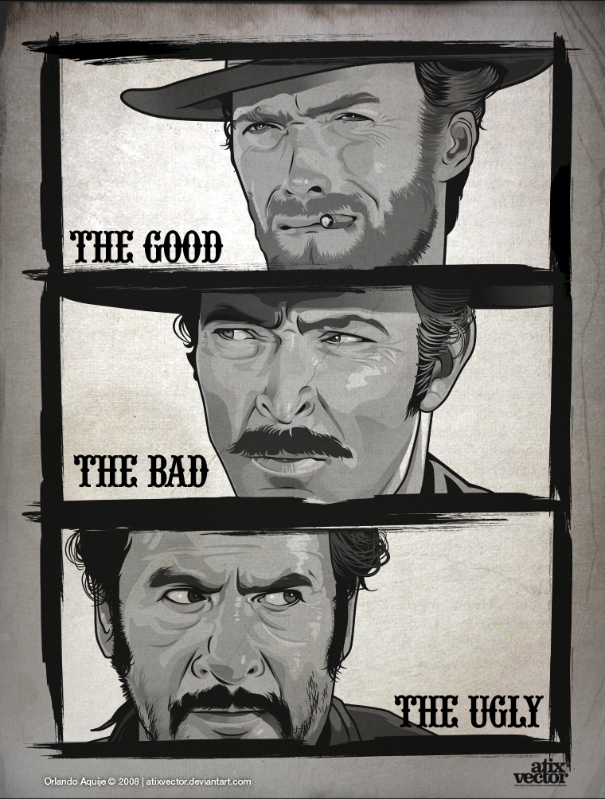
ACT Clinical Supervision
Amy R. Murrell, Ph.D.
Aditi Sinha, M.S.
Rawya Al-Jabari, B.A.
University of North Texas
Contextual Psychology Group

Slide 2
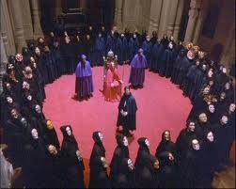
What is this ACT stuff, anyway?
Notes:
People joked that the ACT team was a cult with their own language and philosophy. Students said “Once you go ACT, you don’t go back.”

Slide 3
Misconceptions: Crying is mandatory.
Notes:
Another highly common misconception is that crying is mandatory in supervision. There are fears about the emotionally intense nature of ACT and speaking with supervisors about problems within the supervisory relationship.

Slide 4
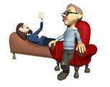
Where are the boundaries?!
Notes:
To date, I can’t tell you how many times I’ve been asked: Do I have to talk about my personal life? And I think at the heart of this question is the fear that ACT knows no boundaries.
Rawya and I are going to assume that you already know that this misconception is false.

Slide 5
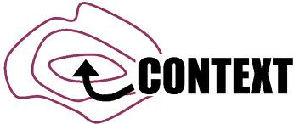
Core Features: Functional Contextualism
What
For?
Context
Behavior
Notes:
A core feature of ACT supervision is based in a functional contextualist philosophy of science. Functional refers to behavior is done for specific reasons and are context-specific. And by context, we mean this broadly to include thoughts, feelings, sensations, memories and interactions with other people.

Slide 6
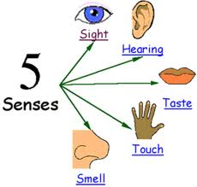
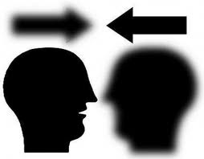
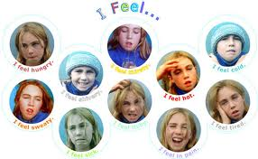
Behaviors that influence therapeutic outcome
Notes:
Functional contextualists are concerned with the prediction and influence of behavior related to therapeutic outcome and how that behavior is maintained. Problem behaviors can arise from or be related to the therapist’s psychological content. So close attention is also paid to this because avoidance can lead to an impaired therapeutic relationship and outcome.

Slide 7
Behaving in service of values
+
Notes:
Because avoidance of our stuff can hurt clients, we have the choice to disclose this in supervision, which can be hard. Emphasis on therapist values and the willingness to experience discomfort in service of being useful to clients, is a core feature of ACT. Doing so often helps flesh out avoidant behaviors that impede therapeutic progress and serves as a powerful motivator.

Slide 8
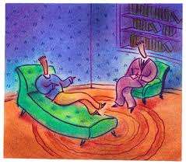
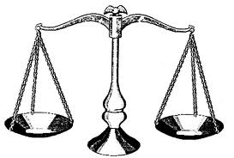
ACT
Experiential and requires active involvement
WCP Stance
Equals- no power differential
Notes:
Because of this, supervision can often “mimic” therapy and is highly experiential, active, and the content focus is on the client, therapist, and the interaction of them and their psychological difficulties. Therapists are not “broken” and seen as whole, complete, and perfect. Accordingly, the therapist and supervisor are considered equals.

Slide 9
What others have to say about it…
This really required willingness from me, to seriously look at when my own stuff was showing up in the room & affecting my work with the client. It was really hard work to do & there was lots of crying during supervision AND it was super helpful for me in letting go of my own avoidant behaviors in session.
You continually integrated my values into our supervision together. You inquired about my values and helped me link my behavior to those valued objectives. This was SO IMPORTANT to me although I didn't' realize it until it was happening. It was the "missing link" for me -- I was able to take more risks with clients because you were always helping me get my behavior in line with my values.
Notes:
The combination of these factors is often a powerful experience for trainees.

Slide 10
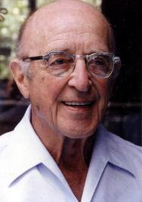
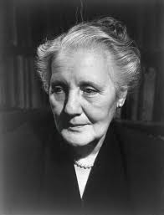
Parallels
Rogers - Person-
Centered Therapy
Object Relations
Therapy
Notes:
ACT supervision equality is also similar to Rogers’ collaborative working relationship and the assumption that the therapist has the resources necessary for success. It is also similar to an Object Relations supervision in which the focus is on the therapist’s understanding of his or her psychology.

Slide 11
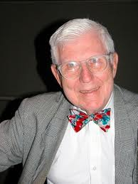
Differences from Traditional CBT
Didactic
Clear power differential
Physical and emotional distance
Note-taking
Notes:
It is dissimilar from traditional CBT models, which are typically more didactic, have a clear power differential, a clear physical and emotional distance, can require note-taking, and the content focus is on the client.

Slide 12
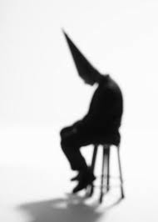
Not good enough…
EEEEEEEK!!!!!
Notes:
As an example, an impactful ACT supervision moment occurred during peer supervision when my values and desire to be helpful and my not good enough feelings were battling. I was working on a family case with my peer supervisor who is a phenomenal clinician.
I felt really insecure, and I was in my head about not being a good enough clinician that it was getting in the way of being effective. We explored my “not good enough monster” and lack of belief in myself. We explored my values and what I wanted to do for our clients. And that meant I had to step up and be heard in session. Even though my monster is still there, I am better able to notice those thoughts and decide what I do next.

Slide 13
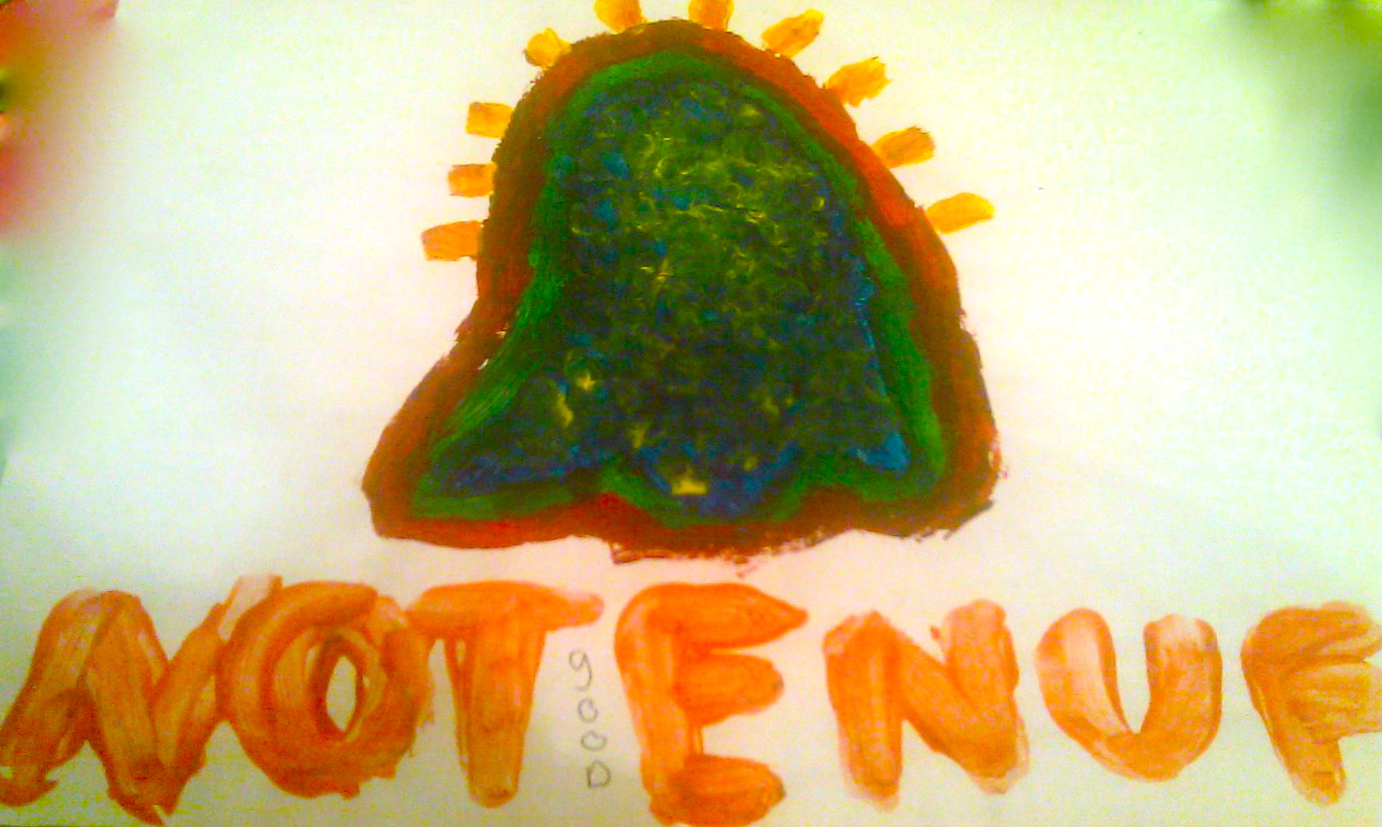
Monster…

Slide 14
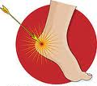
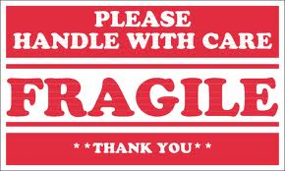
It is okay to cry and care deeply about your clients, Aditi.
Notes:
I have a learning history that crying is equal to weakness and boundary violations. So early on in my training, this lead to avoidant behaviors– like getting tired when hearing about trauma or being “less present” when clients talked about our relationship. I avoided content that would make me cry or think about how deeply I cared.
I cried a lot when I acknowledged the consequences of this and it was hard to feel so vulnerable. I felt embarrassed for crying used to repeatedly apologize for it. But it wasn’t just this accepting space that helped. It was the fact that Amy was okay with showing me her tears when they came up for her too. And this made me understand that crying, caring, and good work were not incompatible. She influenced my behavior because she cared. And I realized that I could have that same effect with my clients if I let myself show up with them too.

Slide 15
Vulnerability and Caring

Slide 16
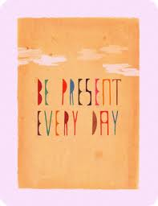
Vulnerability and Caring

Slide 17
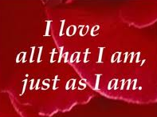
Personal and Professional Impact
Acceptance and Self-compassion
Not broken = freedom
Notes:
This has increased my with clients with complex trauma histories. And with a supervisor that accepted me when I struggled and when I flourished, I’ve learned to do the same for myself and for those that I work with. This has become a whole life approach for me and has given me a sense of freedom and groundedness that I can do whatever what it takes to do my job well.

Slide 18
Personal and Professional Impact

Slide 19
IMPACT
Problems and Sunsets
Notes:
I have learned that people are not problems to be fixed and there are no clear linear answers. instead I recognize people are sunsets. They are intricate, different and meant to be appreciated, not solved. Before, I would have never considered this and it has been important for my development.

Slide 20
UNT Contextual Psychology Group
Notes:
We hope that you understand a little more about ACT supervision and that we’ve piqued your interest in a topic that has made a meaningful difference to us and to clients and professionals alike.

